Slide 1
Forms and Adding New Observations

Slide 2
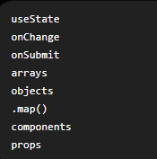
What we are buiding
So far, the observations list are hard-coded. Now we’ll let the user type a new observation into a form and click a button “Add Observation”. Then React will add it to the list immediately.
This lesson combines almost everythin you’ve learned so far:

Slide 3
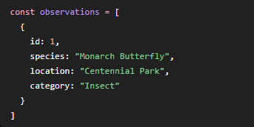
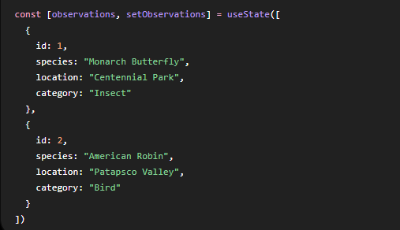
Make the observations array state
In Lesson 4, we had
The problem is that a normal const array does not let React manage changes to the list.
So we change it to state:
Now React can update the observation list.

Slide 4


Create state for the form fields
We need to remember what the user types. Add:
So now our app has four pieces of state:

Slide 5
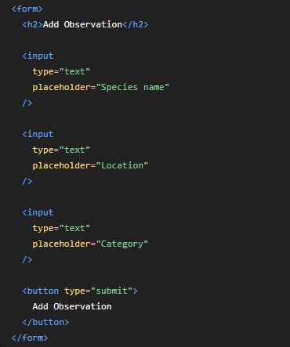
Add the form
Inside your return, add:
At this point, the form appears, but React still isn’t tracking what the user types.

Slide 6
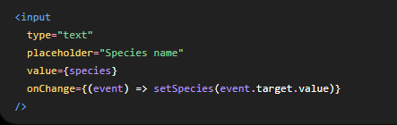
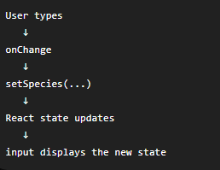
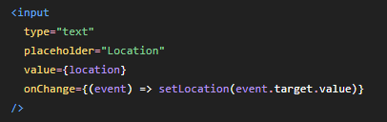
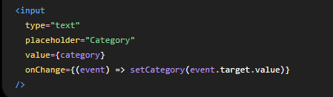
Connect each input to state
Change the first input:
Then the location input:
And category:
Now React always knows what is in each field.
This pattern creates what React calls a controlled input.
The flow is:

Slide 7
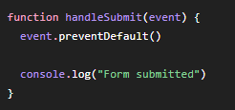


Handle form submission
Normally, submitting an HTML form reloads the webpage. We don’t want that in a React app.
So this line of code means:
Don’t do the browser’s normal form submission behavior.
Let React handle it instead.
Now add this function above the return:
Then change
to:
Now when you click “Add Observation” button, the handleSubmit( ) function runs.

Slide 8
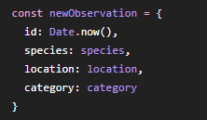

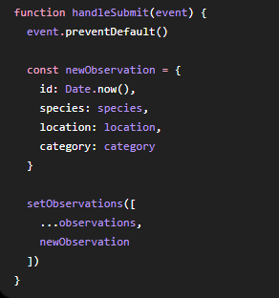
Create a new observation object
Inside handleSubmit, create:
Add it to the array:
So the whole function becomes:

Slide 9


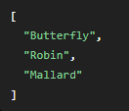
What does …observations mean”
This is JavaScript’s spread operator.
Suppose:
Then:
Becomes:
A new array containing all existing observations plus the new one.

Slide 10

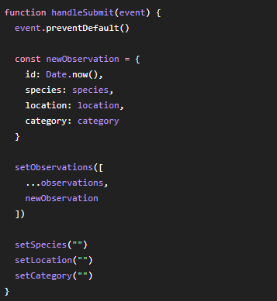
Clear the form afterward
After adding the observation, add:
Now:
After clicking “Add Observation”, the fields become empty again.

Slide 11
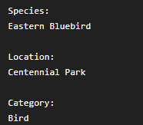

Complete App.jsx
See attached App_lesson5.jsx and ObservationCard_lesson5.jsx.
Try adding an observation. Enter:
Click “Add Observation” button.
You should immediately see shown on the webpage.

Slide 12
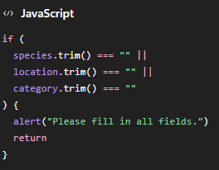
Add simple validation
Right now, the user could submit an empty form. Let’s prevent that.
At the beginning of handleSubmit( ), add:

Slide 13
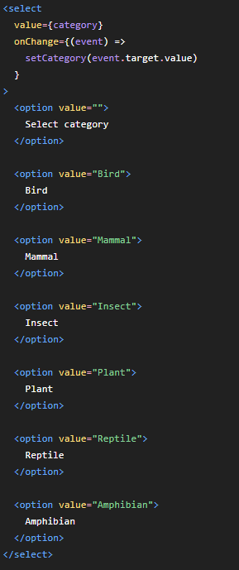
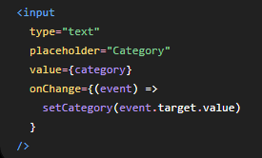
Improve category with a dropdown
For biodiversity data, category is better as a dropdown than a text box.
Replace : with
Now the user selects from a list.

Slide 14
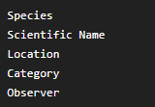
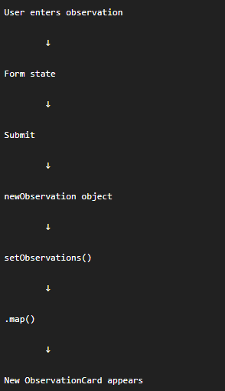
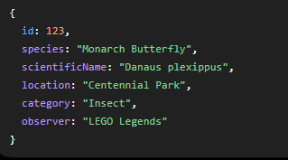
Challenge
Build a form with:
Your object should look like:
Then display all five fields in
ObservationCard.
The final flow should be:

